Slide 1
SEO

Slide 2
Image Optimization
Proper images names
Alt tag
<img src= ”….” alt= “digital marketing” style=”margin-left: -7px” class= “img-responsive”>
Screen reader can read the image text in alt attribute

Slide 3
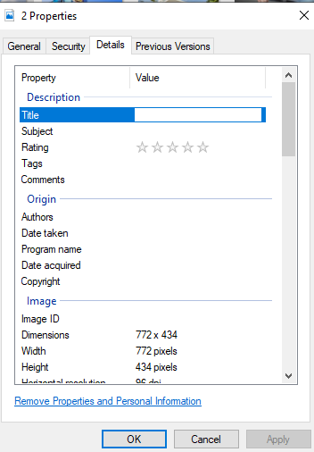
Image Properties

Slide 4
Images Compression
Compress and Resize Photos and lazy-Load
Images size less than 100KB
Compress Image website name
Type the Compress Image
Compress jpeg
Tiny png
Image compressor

Slide 5
WordPress
All images compress
Plugins
1) WP-Optimize - Clean, Compress, Cache Plugins→ WP-Optimize-Cache, Clean, Compress. → install→ Activate→ installed plugin → optimize→ images→ compress images→ automatically newly added images →best image quality → range set in mid → custom →images upload → select → compress the selected images
2) Smush – Optimize, Compress and Lazy Load Images
Lazy load → image loading → enable lazy load → free tool → Plugin → Smush- Lazy Load Images, Optimize and Compress Images →install → activate → bulk smush → bulk smush now → save changes →lazy load → activate → media types , display and animation , fade In , Spinner , Placeholder )
Duration and delay
Save changes
If you want to remove the lazy load
Click on the Deactivate button

